Slide 1
Policy-in-the-Loop
A Survey of Legislative and Regulatory Proposals to Increase Human Control Over AI
Hodan Omaar
Policy Analyst, Center for Data Innovation
May 28, 2020
Notes:
Notes

Slide 2
AI Policy Landscape
International Efforts
National Effort
Independent Agency Regulations
Federal Agency Regulations
Notes:
Notes

Slide 3
International Efforts
1 of the 5 OECD AI Principles is human-centered values and fairness.
G20 AI Principles, which are drawn from the OECD Recommendation.

Slide 4
National Efforts
A February 2019 Executive Order established the American AI Initiative, which is guided by five principles
Driving technological breakthroughs
Driving the development of appropriate technical standards
Training workers with the skills to develop and apply AI technologies
Protecting American values including civil liberties and privacy and fostering public trust and confidence in AI technologies
Protecting US technological advantage in AI, while promoting an international environment that supports innovation.

Slide 5
Department of Defense
The current policy DOD Directive 3000.09 (2017) says:
“It is DOD policy that an autonomous and semi-autonomous weapons system shall be designed to allow commanders and operators to exercise appropriate levels of human judgment over the use of force.”

Slide 6
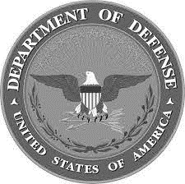
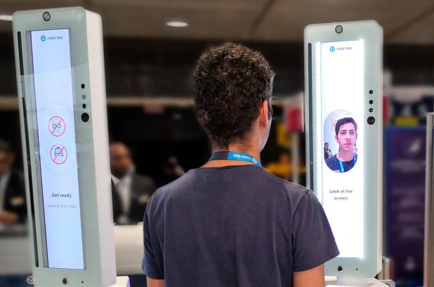
Department of Homeland Security &
Department of Justice
How do false negatives and false positives impact human operators?

Slide 7
Department of Health and Human Services - FDA
April 2019 FDA published: Proposed Regulatory Framework for Modifications to Artificial Intelligence/Machine Learning (AI/ML)-Based Software as a Medical Device (SaMD).

Slide 8
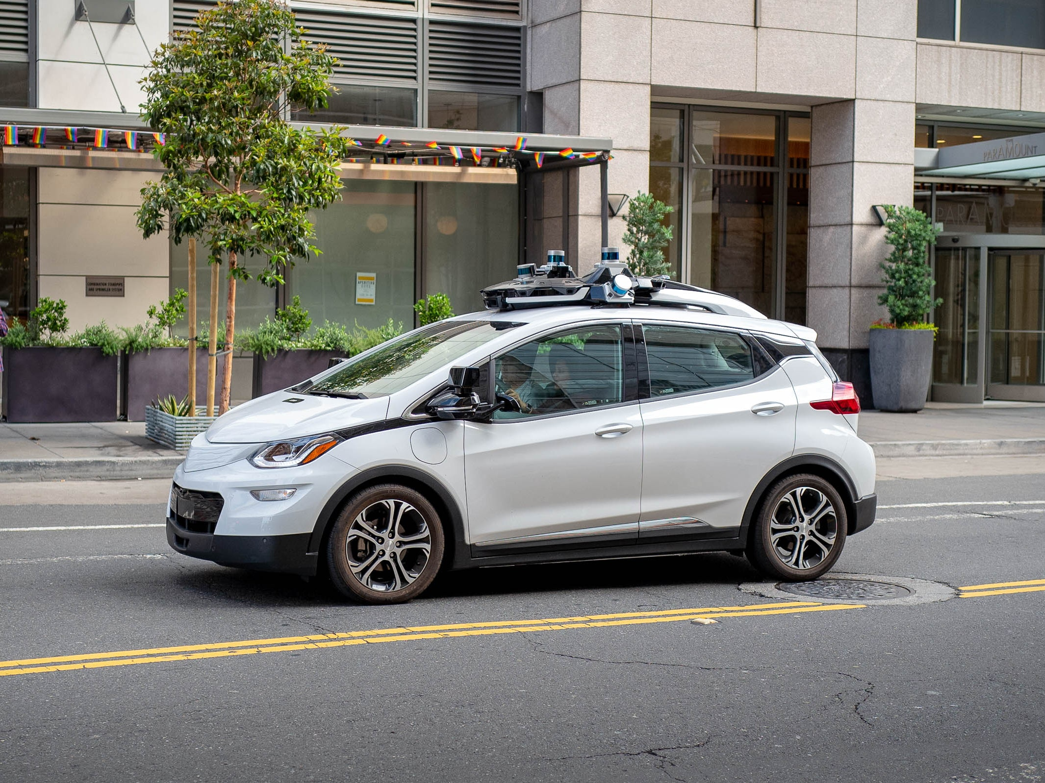
Department of Transportation
SELF DRIVE Act in 2017 , speeds the adoption of self-driving cars and bar states from setting performance standards.
Many problems that plague this effort as tech industry and advocates, lawyers and local officials fail to agree.

Slide 9
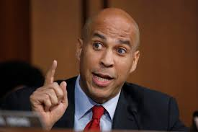
Federal Trade Commission
The Algorithmic Accountability Act (April 2019).
Targets only automated high-risk decision making, not all high-risk decision making
Does not consider non-linear process of development & deployment
Only applies to companies worth over $50 million

Slide 10
AI Policy Landscape
International Efforts
National Effort
Independent Agency Regulations
Federal Agency Regulations

Slide 11
Thank you.
Hodan Omaar
homaar@datainnovation.org
@datainnovation @hodanomaar

